Slide 1
Foundation of Human Skills
FYBMS
Semester I
Prof. Muskan Jeswani

Slide 2
Syllabus:
Unit I: Understanding of Human Nature
Unit II: Group Behaviour
Unit III: Organization Culture
Unit IV: Organizational change and creativity

Slide 3
CHAPTER 1. Individual Behaviour
● Introduction of Human Nature ● Individual Differences ● Nature and Significance of Individual Difference ● Inter- and Intra-Individual Differences ● Factors Affecting Individual Difference

Slide 4

Introduction to human nature
Human nature is a topic of general interest
Man is a social animal – He always lives in a Society
Can he survive alone without the society, family, colleagues or friends?
A person has to be depended on others for satisfying his needs to have the ability to get the work done.
“Human skill is the ability to work with, understand and motivate other people both individually and in groups”, for e.g., through human skill, a manager can take maximum advantage from other materials of organization such as money, technology and raw material
Study of human nature deals with personality, attitudes, intelligence, thinking, abilities, values, learning and perception.

Slide 5
Individual differences
All individuals are not equal. They all differ from each other not only in physical characteristics but also in behavioral characteristics.
Individual differ from each other in qualitative as quantitative ways. The science that studies these qualitative and quantitative differences among people is known as the study of individual differences (also called as differential psychology).
Meaning: Individual differences means differences between individuals which makes one a unique individual.

Slide 6
Differences
Intra Individual
Inter Individual
Lets understand this with an example
All differences among persons in their attitude, physical features, intelligence, personality, interest, learning etc. It refers to differences in a particular characteristics among various individuals
Intra-individual differences refers to differences among various characteristics possessed by the same person. Different abilities are present in the same person,

Slide 7
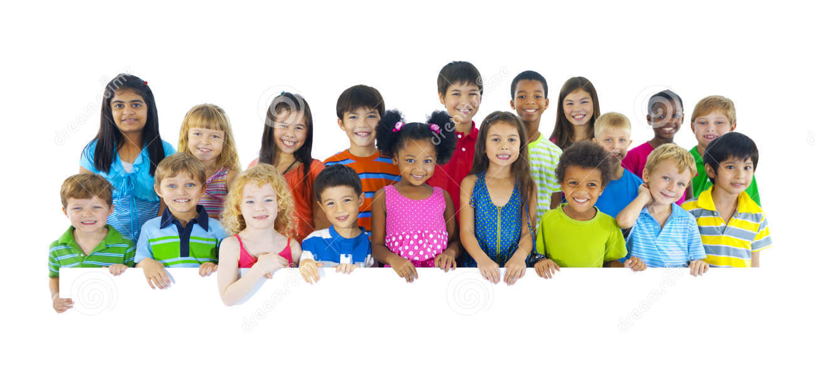
Inter-Individual Differences
Each kid is very different from the other.
Personality
Attitude
Emotions
Intelligence
Learning
Interests

Slide 8
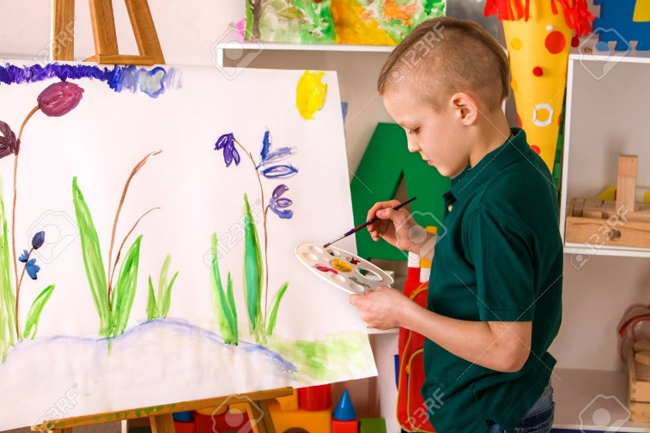

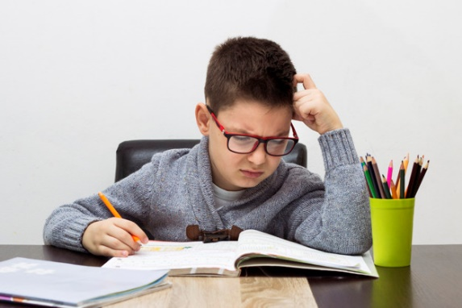
Intra Individual Differences
Shyam’s Intra Individual Differences
Excellent in painting
Not so good in singing
Worst in studies

Slide 9
FACTORS AFFECTING INDIVIDUAL DIFFERENCE
1. Emotional Differences
2. Differences in Intelligence
3. Differences in Abilities, Attitudes and Achievement
4. Differences in Social Behaviour
5. Gender Differences
6. Physical differences: (a) Difference in chronological age (b) Difference in physical maturity (c) Difference in appearances:

Slide 10
Periods of human life span
Prenatal stage (conception to birth)
Infancy and toddlerhood (birth to age of 3)
Early childhood (3 to 6 year)
Middle childhood (6 to 12 years
Adolescence (12 to 20 year)
Young adulthood (20-40 years)
Late adulthood (65 years onwards)
Middle age (40 – 65 years)

Slide 11
What we know about human behavior
Psychological findings
Human beings are biological creatures
Every person is different yet much the same
People can be understood fully only in the context of their culture ethnic, identity and gender identity
Human lives are in a continuous process of change
Behavior is motivated
Behavior has multiple causes
Humans are social animals
People play an active role in creating their experiences
Behavior can be adaptive or maladaptive

